Slide 1
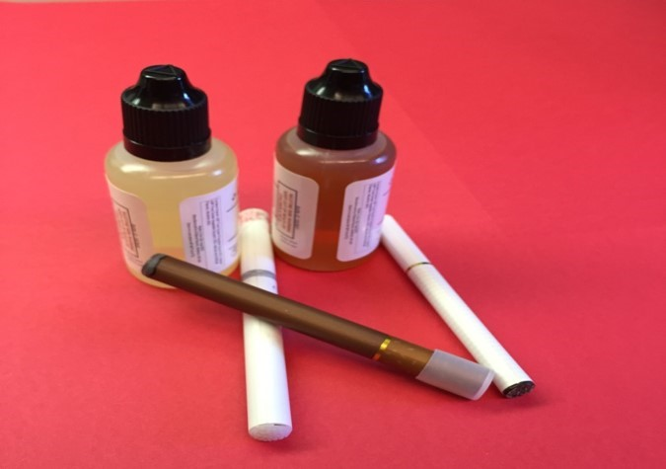
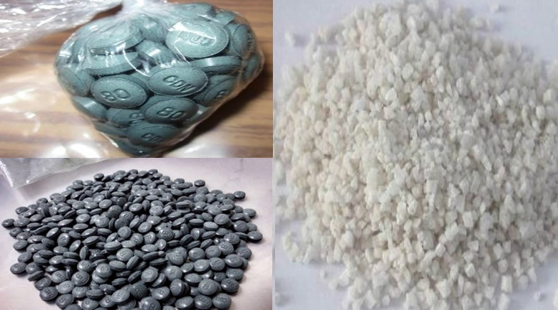
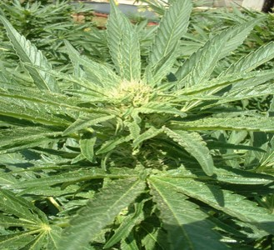
EMERGING DRUG TRENDS
Fiorella Carhuaz, CHES
Public Health Educator
Oregon Poison Center

Slide 2
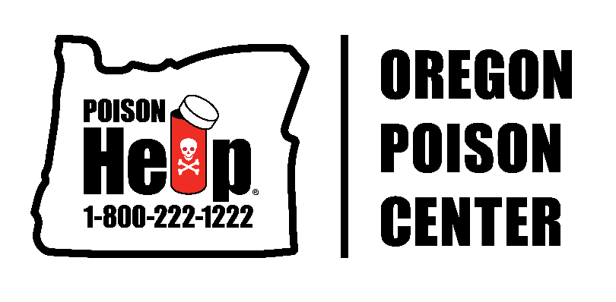
The Poison Center answers calls from the public and health care providers.
We serve the residents of Oregon, Alaska & Guam.
Who answers the calls? Nurses, Pharmacists and Doctors.
What are your hours? Open 24/7.
Does it cost? No, we are a free resource.
What’s the number? 1-800-222-1222.

Slide 3
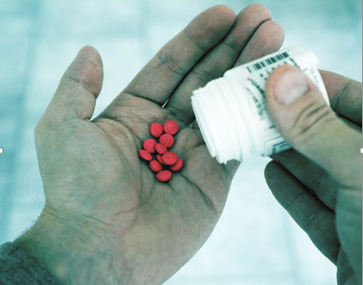
TEENS- Sharing Pills Can Kill
According to the Office of National Drug Control Policy:
Four out of 10 teens think that prescription medicines are safer to abuse than illicit drugs.
Nearly 1/3 of teens believe there's nothing wrong with using prescription medicines without a prescription once in a while.
Nearly three out of 10 teens believe prescription painkillers aren't addictive.

Slide 4
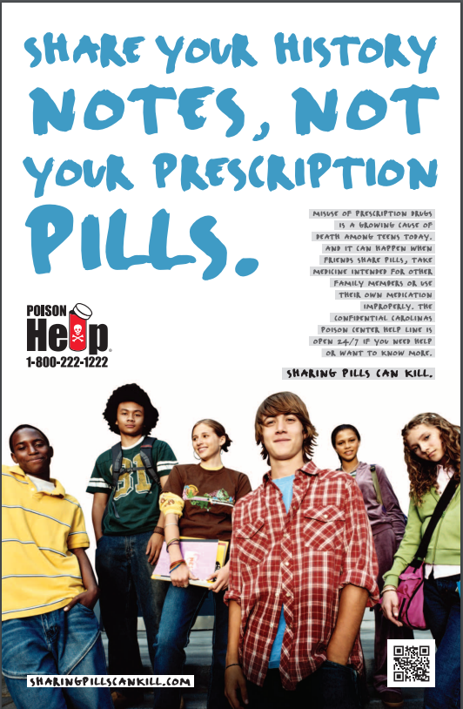

Slide 5
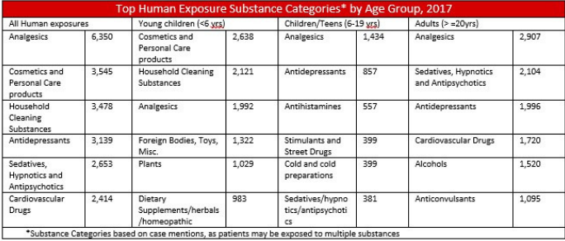
THE PROBLEM

Slide 6
OPIOIDS
Opium is derived from poppy plant papaver somniferum
  Newer semi-synthetic and synthetic, more potent forms available now
  Prescription narcotic abuse considered an epidemic in this country
  Analgesics number 1 drug category called into the Poison Center

Slide 7
DEFINITIONS
  Opiate-naturally derived directly from the poppy plant
    Morphine and codeine
  Semisynthetic opioid-synthesized via modification of natural opiates
    Heroin, hydromorphone, hydrocodone, oxycodone
  Synthetic opioid not derived from opiates but binds to opiate receptors and produces similar effects
    Fentanyl, meperidine, methadone, tramadol and propoxyphene

Slide 8
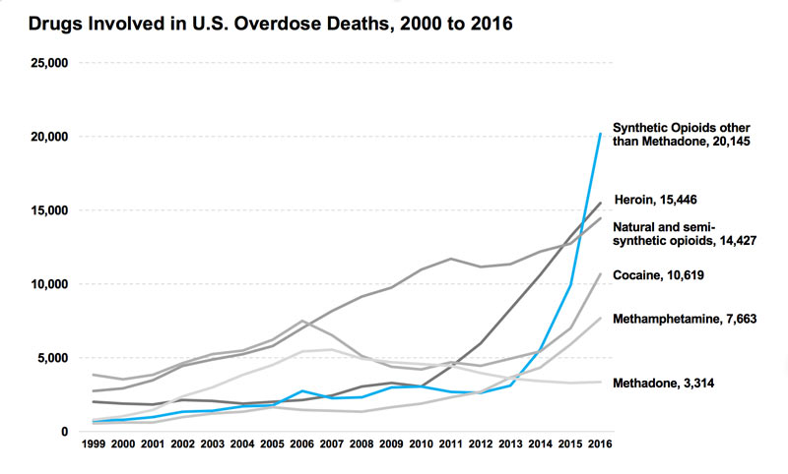
DRUGS INVOLVED IN OVERDOSE DEATHS

Slide 9
DRUG: HEROIN
Origin:
Opium grown SE Asia, Mexico and S.America
Names:
Big H , Black Tar, Chiva, Hell Dust, Negra, Horse, Smack and Thunder.
Effects:
Addiction. Drowsiness, respiratory depression, constricted pupils, nausea, a warm flushing of the skin, dry mouth, and heavy extremities
Overdose Effects:
Slow and shallow breathing, blue lips and fingernails, clammy skin, convulsions, coma, and possible death

Slide 10
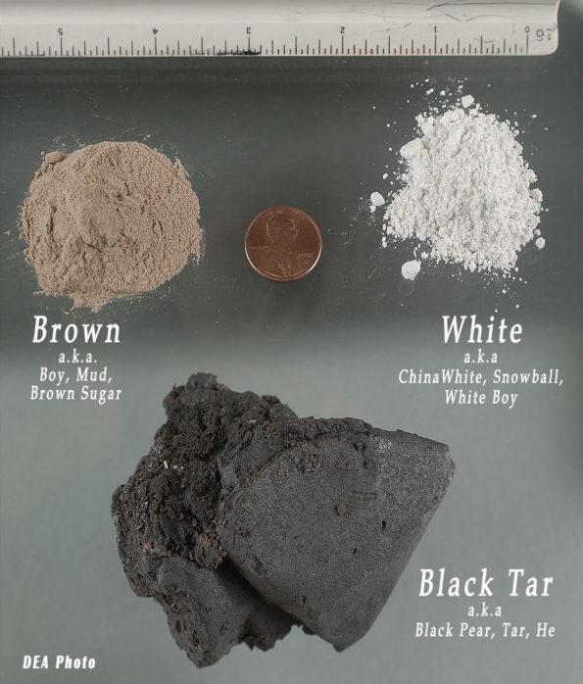

Slide 11
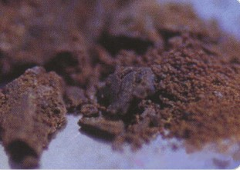
Brown Heroin-less pure (Black Tar). Can look like molasses or dirt.
China White
CUT with:
Talc, lactose, baking powder, sugar/molasses, dirt/shoe polish
Caffeine and Other opioids.

Slide 12
SNORT OR INJECT
Snort=white heroin
Injection=heroin is cooked and then aspirated into a syringe.
Chasing the dragon= Vaporizing black tar. A user puts the heroin on a piece of foil and heats the foil with a lighter underneath it. The user uses a straw or similar apparatus and inhales the vapor.
Did you know? Heroin can be distributed in balloons.
This is done so that the drug can be easily swallowed in order to concealed possession of the drug while trafficking.

Slide 13
SIGNS OF AN OPIOID OVERDOSE
NO RESPONSE TO STIMULI
SHALLOW, LABORED OR NO BREATHING
CANNOT BE WOKEN UP
SNORING OR GURGLING
BLUE/GREY LIPS OR FINGER TIPS
FLOPPY ARMS OR LEGS

Slide 14
HEROIN WITHDRAWAL
Goose bumps, yawning, cramping, vomiting, rhinorrhea (nasal congestion).
It is very painful (body pain).

Slide 15
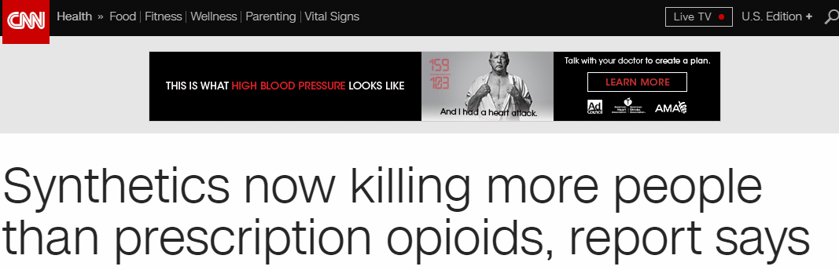
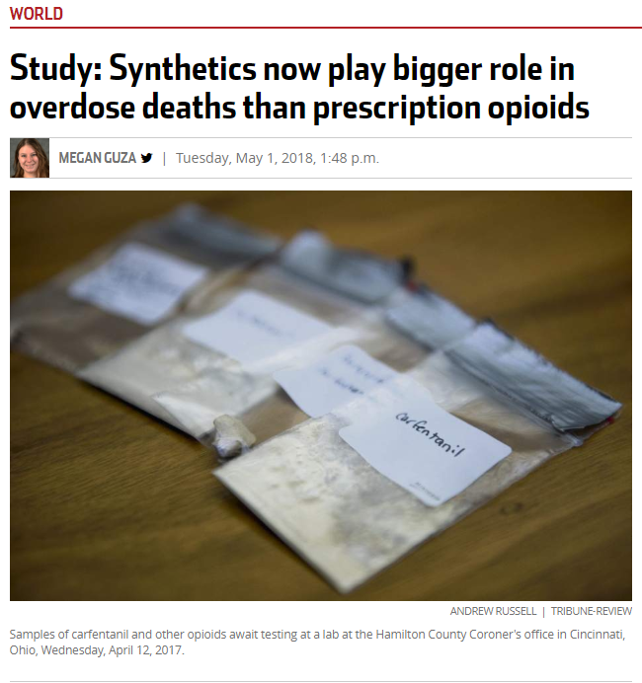
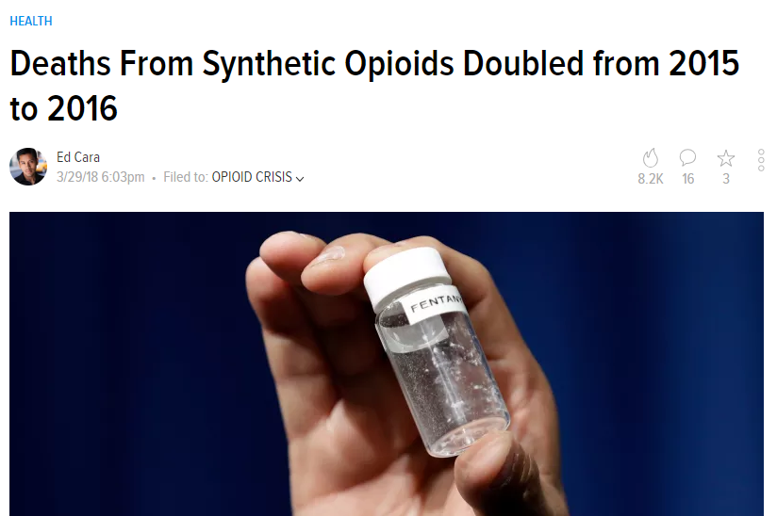

Slide 16
SYNTHETIC OPIODS:
Definitions
  Opiate-naturally derived directly from the poppy plant
    Morphine and codeine
  Semisynthetic opioid-synthesized via modification of natural opiates
    Heroin, hydromorphone, hydrocodone, oxycodone
  Synthetic opioid not derived from opiates but binds to opiate receptors and produces similar effects
    Fentanyl, meperidine, methadone, tramadol and propoxyphene

Slide 17
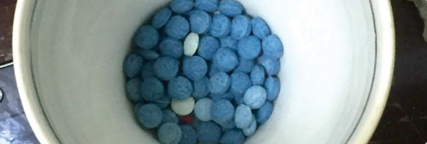
DRUG: FENTANYL

Slide 18
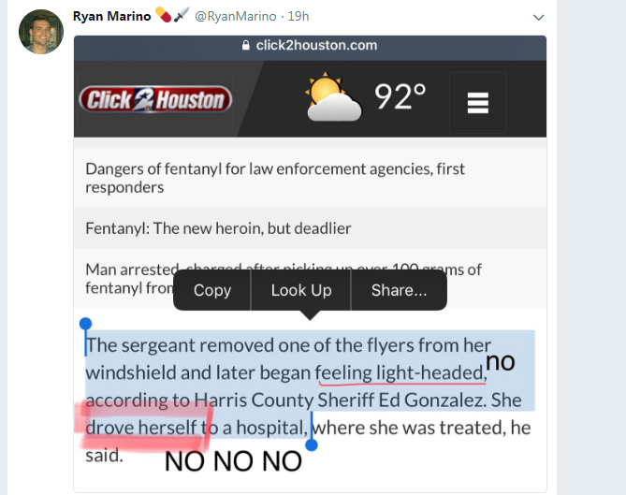
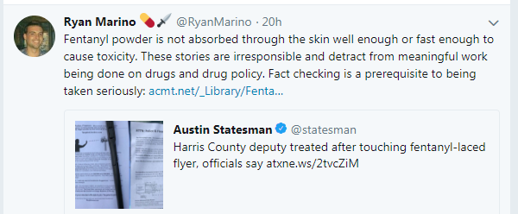

Slide 19
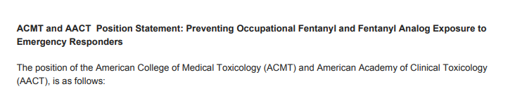
https://www.acmt.net/_Library/Fentanyl_Position/Fentanyl_PPE_Emergency_Responders_.pdf

Slide 20
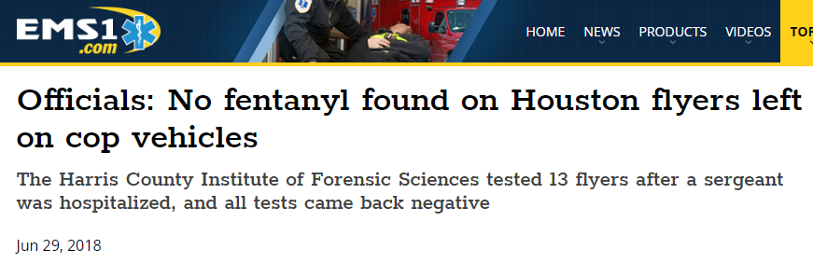

Slide 21
FENTANYL
Origin:
Fentanyl was first developed in 1959 and introduced in the 1960s as an intravenous anesthetic. It is legally manufactured and distributed in the United States. Licit fentanyl pharmaceutical products are diverted via theft, fraudulent prescriptions, and illicit distribution by patients, physicians, and pharmacists. From 2005 through 2007, both fatal overdoses associated with abuse of clandestinely produced fentanyl and law enforcement encounters increased markedly. According to the Centers for Disease Control and Prevention, there were 1,013 fatal overdoses recorded from April 2005 to March 2007. More recently, there has been a re-emergence of trafficking, distribution, and abuse of illicitly produced fentanyl with an associated dramatic increase in overdose fatalities.
Names:
Apache, China Girl, China Town, Dance Fever, Friend, Goodfellas, Great Bear, He-Man, Jackpot, King Ivory, Murder 8, and Tango & Cash

Slide 22
FENTANYL
100x more potent than morphine
Used medically as a painkiller
  Lollipop
  Patch
    Used patches present risks
Often adulterated into heroin or counterfeit oral painkillers
Overdose and death likely underreported
  Clinical presentation similar to other opioid overdoses
  May not show up on urine drug screen
Standard therapy and doses of naloxone may not be of benefit due to drugs affinity to receptors
  Airway support
  IV naloxone

Slide 23
FENTANYL
Effects:
Fentanyl, similar to other commonly used opioid analgesics(e.g., morphine), produces effects such as relaxation, euphoria, pain relief, sedation, confusion, drowsiness, dizziness, nausea, vomiting, urinary retention, pupillary constriction, and respiratory depression.
Overdose Effects:
Overdose may result in stupor, changes in pupillary size, cold and clammy skin, cyanosis, coma, and respiratory failure leading to death.

Slide 24
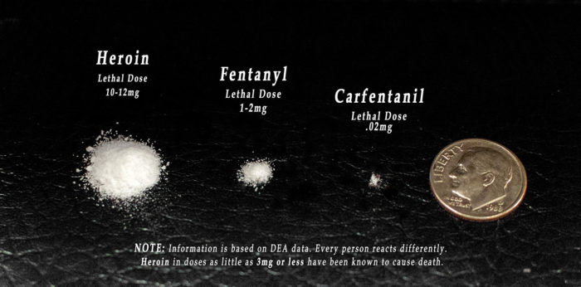

Slide 25
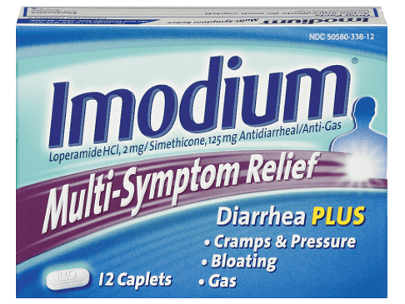
DRUG: IMMODIUM (Loperamide)
Inexpensive OTC anti-diarrheal opioid receptor activity
  • 200 - 400 tablets of Loperamide 2 mg daily
  • Produces cardiac conduction abnormality
  • Mechanism of toxicity unknown
Due to Abuse, FDA has put limits on package sizes
Overdoses can be fatal
Respiratory depression
    Cardiac arrhythmias

Slide 26
DRUG: XANAX
This drug increase dopamine release. These unusually high levels of dopamine trigger pleasurable emotions and sensations. Users sometimes refer to this feeling as the “Xanax high.” People who abuse Xanax are typically seeking this sedative effect. As a result, this Xanax high reinforces the desire for repeated use.
Sold in forms of bars. Xannies or zannies, handlebars, bars, and blue footballs are all commonly used street names for Xanax.
In high doses, patients may manifest coma and respiratory depression.

Slide 27
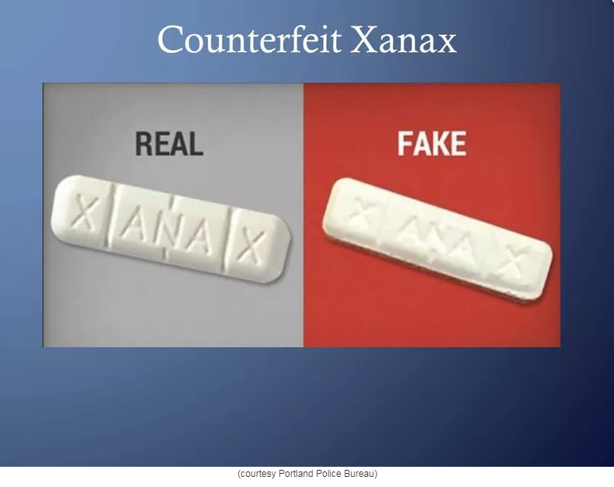
DRUG: COUNTERFEIT XANAX
It gets worse:
Counterfeit Xanax. You never what’s in it.
Portland police warning community about counterfeit prescription drugs
Posted: Oct 16, 2017 12:18 PM PDTUpdated: Oct 16, 2017 12:19 PM PDT

Slide 28
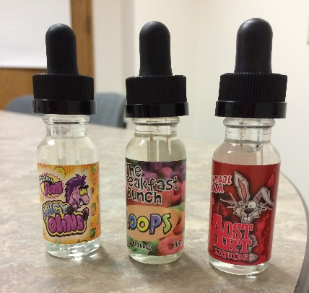
DRUG: E-LIQUID /LIQUID NICOTINE
Liquids or “Juices” typically have 4 ingredients:
  Liquid nicotine
  Propylene glycol
  Vegetable glycerin
  “Flavoring”

Slide 29

CROSS ENCOURAGEMENT
ADDICTIVE BEHAVIORS
Flavor: everything from grape to gummy bear to lemon drop martini and even chocolate. Cross-encouragement of other addictive behaviors.
Do comparison to regular cigs in terms of nicotine content, and then also add in price.
Talk about Nicotine as a drug: it’s an addictive stimulant; original use was as a pesticide; when exposed to too much it’s a CNS depressant; some case reports suggest that as little as a mouth full (~1 teaspoon) is enough of an e-liquid to be lethal to a child

Slide 30
DRUG: E-LIQUID /LIQUID NICOTINE
High doses of Nicotine
  Nausea
  Lethargy
  Central nervous depression
  Respiratory depression
  Death

Slide 31
DRUG: MARIJUANA
In general...
  Toxicity is mild
  Effects not prolonged and usually not life threatening
  Potentially problematic in children who ingested edibles or abuse of hash oil
Psychiatric effects predominate
  Usually a sense of well being and relaxation, euphoria, “dream-like”state
  Use of marijuana in naïve users or using large amounts can produce more significant symptoms
    Anxiety, paranoia, acute psychosis or obsessional thinking
Impairment of speech and fine motor skills
  Increased risk for MVA

Slide 32
DRUG: MARIJUANA
Various different cannabinoids out there
  THC most common and used to achieve the characteristic high
  CBD popular in medical marijuana due to its anti-inflammatory/analgesic effects
Smoking marijuana produces a high within 8-10 minutes and last around 4-6 hours
  Impairment, including fine motor skill impairment, can last up to 24 hours
Ingesting marijuana produces high from 1 hour to 3 hours
  Potential for “Overdose” if patient redoses multiple times

Slide 33
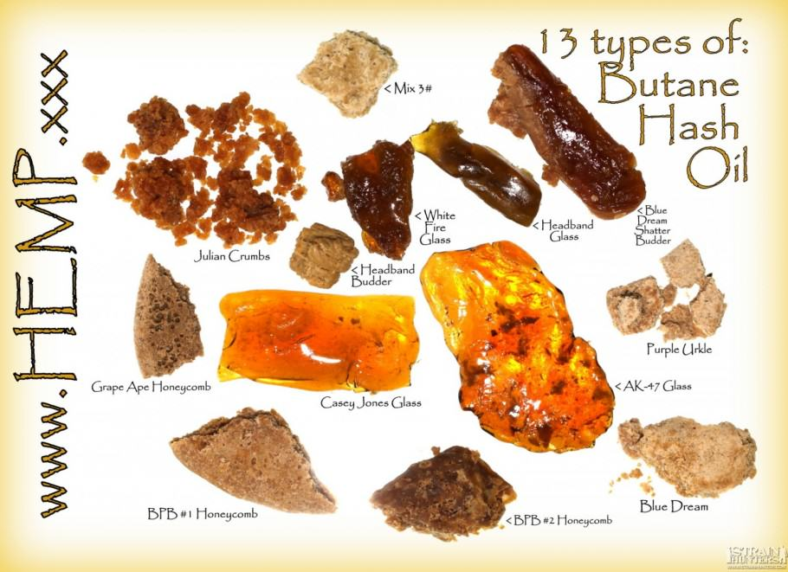
DRUG: MARIJUANA
Butane Hash Oil (BHO) or dab
  Dangerous manufacturing which can be explosive
  Highly concentrated form of THC
    Up to 95% THC
    Plant typically up to 20% (8-12% more common)

Slide 34
DRUG: MARIJUANA
Homemade edibles
  Unknown concentration or if other drugs present
Many edibles easily confused with commercial products intended for children

Slide 35
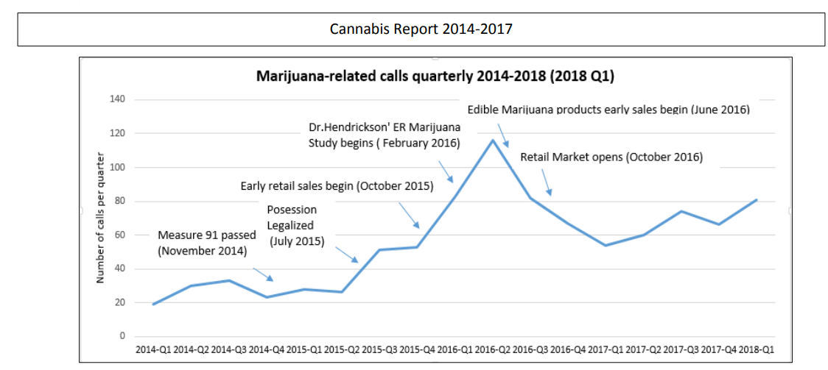
TRENDS

Slide 36
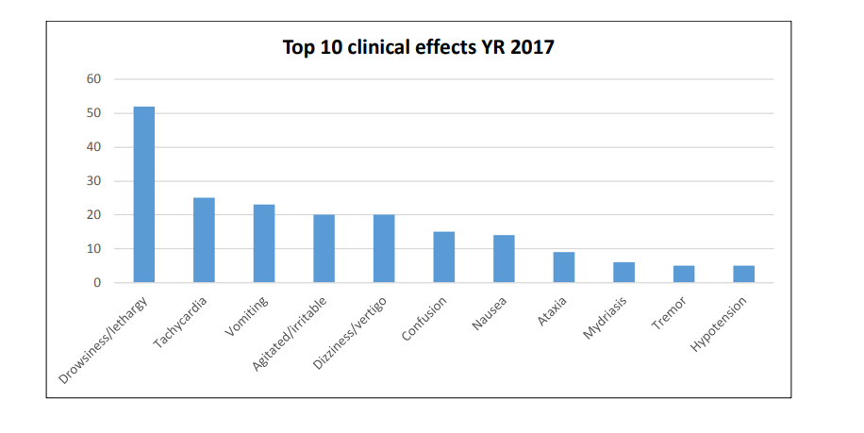
SYMPTOMS

Slide 37
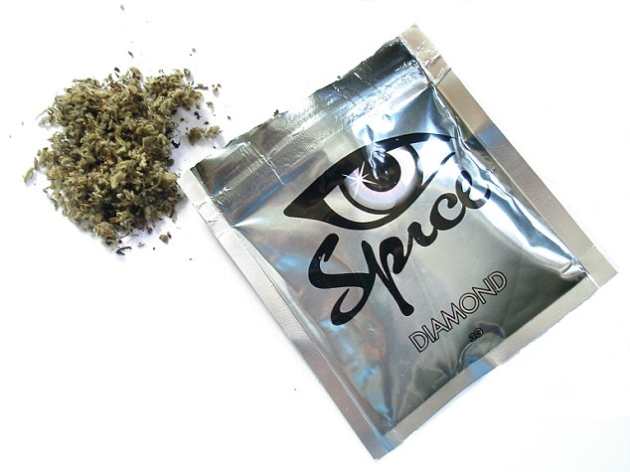
DRUG: SYNTHETIC CANNABINOIDS
Illegal as of May 2013
  DEA classified as Class 1 Drug
Several drugs
  Spice/K2
    Up to 800x more powerful then marijuana
  B-FUBINACA/ AK-47 24 Karat Gold
    50 x more powerful then K2
Per DEA, Synthetics are coming from China, same with synthetic opiates
  Patents are published and use by foreign nations

Slide 38
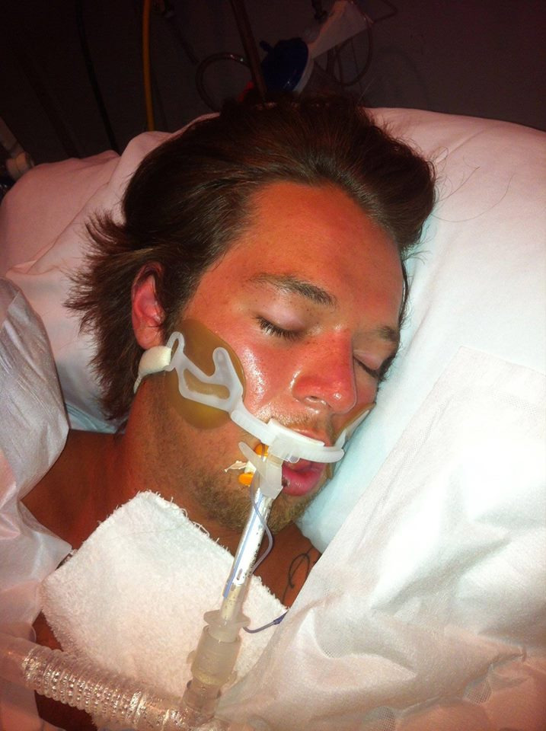
DRUG: SYNTHETIC CANNABINOIDS
Extremely addictive
  Compared to Heroin or Cocaine
Health effects
  Severe agitation and anxiety.
  Fast, racing heartbeat and higher blood pressure.
  Nausea and vomiting.
  Muscle spasms, seizures, and tremors.
  Intense hallucinations and psychotic episodes.
  Suicidal and other harmful thoughts and/or actions.
Can cause Death
  Hyperthermia, Seizures, Heart attack, Coma, Kidney damage, & Brain Edema among others
Jan 1,2016 to Jun 30th, Poison Centers received 4,270 calls regarding exposures
  Few cases in Washington

Slide 39
RECOMMENDATIONS:
If you think you are dealing with a poison, call us right away.
1-800-222-1222
Get information from the right sources. News sometimes do not have the correct any information. You can call us if you have a poison/poisoning question. Handling information calls is part of our job.

Slide 40
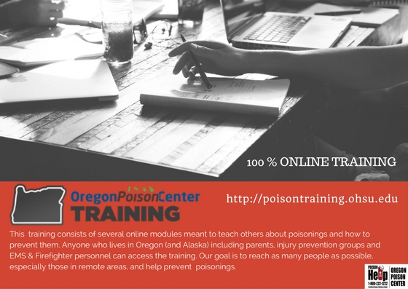
Take our online training. It’s like poison safety 101!
Poisontraining/ohsu.edu

Slide 41

CALL THE EXPERTS:
PoisonHelp.org- quick recommendation for single substance exposure

Slide 42

PoisonHelp Line
1-800-222-1222

Slide 43
QUESTIONS?

Slide 44
DRUG: CARFENTANYL
Analog of synthetic opioid fentanyl
  10,000x more potent than morphine
  100x more potent than fentanyl
Often adulterated into heroin or counterfeit oral painkillers
Standard therapy and doses of naloxone unlikely to be of benefit
2mg of carfentanil,
enough to
incapacitate a 2,000lb
elephant, next to a
penny. Source: DEA

